Slide 1
A Brief Introduction to Artificial Intelligence
Minlie Huang （黄民烈）
aihuang@tsinghua.edu.cn
http://aihuang.org/p
Notes:
Please retain proper attribution, including the reference to ai.berkeley.edu. Thanks!

Slide 2
The Turing Test (1950)
”Can machines think?”
Q: Please write me a sonnet on the subject of the Forth Bridge. A: Count me out on this one. I never could write poetry.
Q: Add 34957 to 70764.
A: (Pause about 30 seconds and then give as answer) 105621.
Tests behavior — simple and objective

Slide 3
Eugene Goostman in 2014
Eugene is a 13 year old Jewish boy from Ukraine who likes computer games…

Slide 4
Scott Aaronson v. Eugene Goostman
Scott: Which is bigger, a shoebox or Mount Everest?
Eugene: I can’t make a choice right now. I should think it out later. And I forgot to ask you where you are from.
Scott: How many legs does a camel have?
Eugene: Something between 2 and 4. Maybe, three? :-))) By the way, I still don’t know your specialty
- or, possibly, I’ve missed it?
Scott: How many legs does a millipede have?
Eugene: Just two, but Chernobyl mutants may have them up to five. I know you are supposed to trick me.
Scott: No, I need to know that you’re not a chatbot. Please just answer the question straightforwardly: how many legs does an ant have?
Eugene: Something between 2 and 4. Maybe, three? :-))) Oh, what a fruitful conversation;-)
Scott: Do you understand why I’m asking such basic questions? Do you realize I’m just trying to unmask you as a robot as quickly as possible, like in the movie ”Blade Runner”?

Slide 5
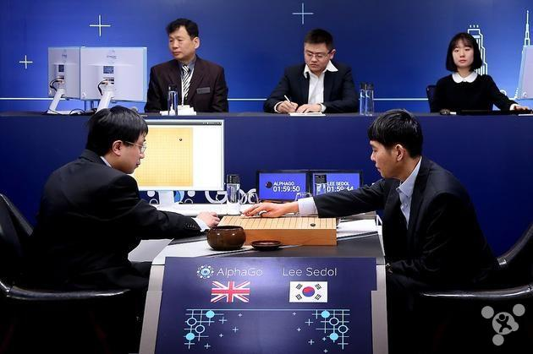
Who has passed Turing Test?
1997: Deep Blue (chess)
2016: Alpha Go beats 李世石
2011: IBM Watson (Jeopardy!)

Slide 6
Who has passed Turing Test?
Human-level concept learning through probabilistic program induction
Science 11 Dec 2015: Vol. 350, Issue 6266, pp. 1332-1338 DOI: 10.1126/science.aab3050
Notes:
第一个图，1是机器；第二个图 2是机器

Slide 7
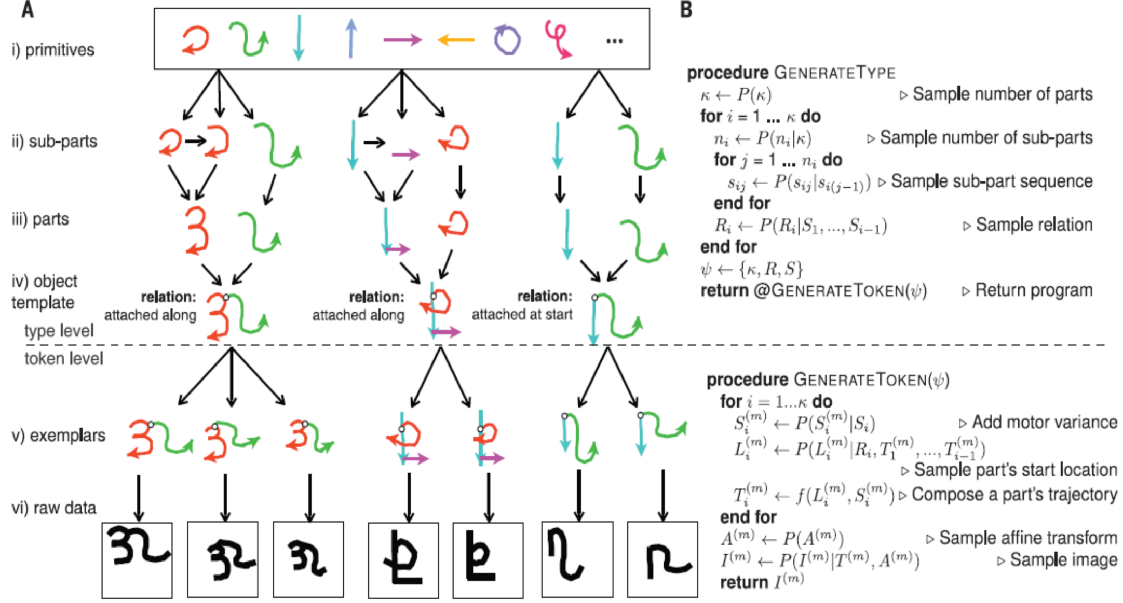
Baysian Programming Learning

Slide 8
Poetry Creation
早梅1
春信香深雪
冰肌瘦骨绝
梅花不可知
何处东风约
早梅2
一树寒梅白玉条
迥临村路傍溪桥
不知近水花先发
疑是经冬雪未销
Notes:
1：机器人；
2：唐代张谓诗作
http://baike.baidu.com/subview/275596/7946863.htm

Slide 9
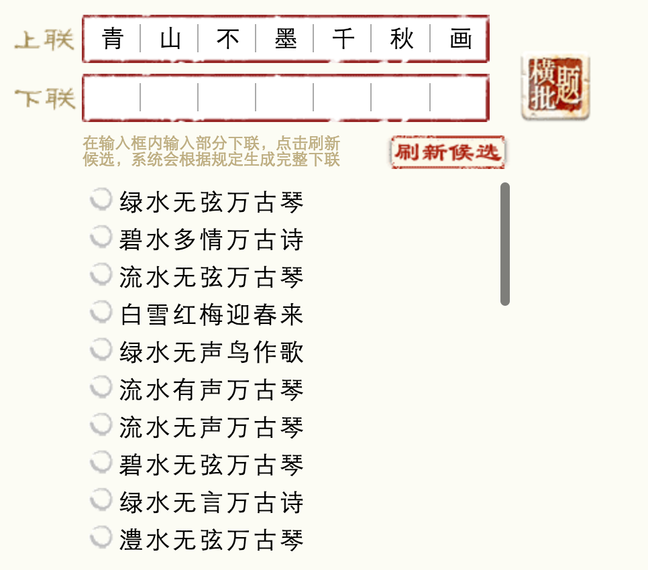
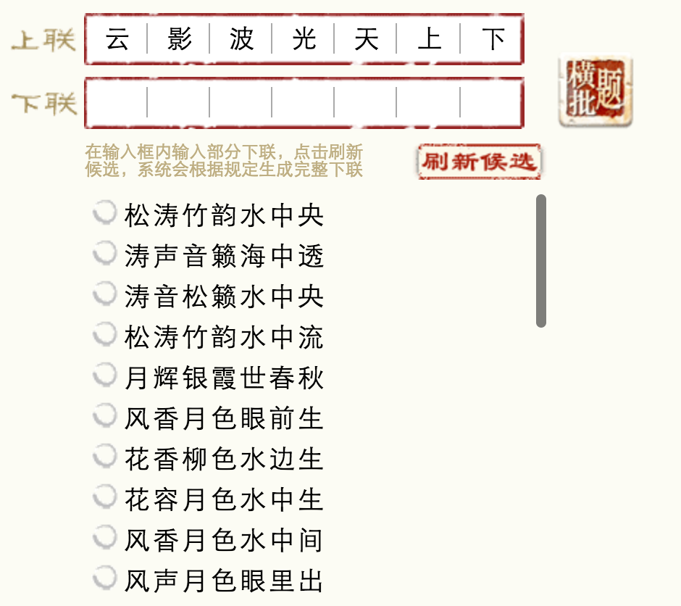
Couplet Generation
http://couplet.msra.cn/app/couplet.aspx
Notes:
1、青山不墨千秋画，流水无弦万古琴。
2、身比闲云，月影溪光堪证性；心同流水，松声竹色共忘机。（王剡题天台万年寺联）
3、一经飞红雨；千林散绿荫。（龙门联）
4、山静水流开画景；鸢飞鱼跃悟天机。
5、五车诗胆；八斗才雄。
6、大块焕文章，白云在天，沧波无际；春风扇淑气，杂树生花，群莺乱飞。
7、问青牛何人骑去；有黄鹤自天飞来。
8、临水开轩，四面云山皆入画；凭栏远眺，万家烟火总关情。（大光亭）
9、古今奇观属岩壑；往来名士尽风流。（杨树悬山阴自在亭）
10、云影波光天上下；松涛竹韵水中央。（止息亭联）
11、雨过林霏清石气；秋将山翠入诗心。（止息亭联）
12、留此湖山 得此佳趣；召以佳景 假以文章。（水月观音亭）

Slide 10
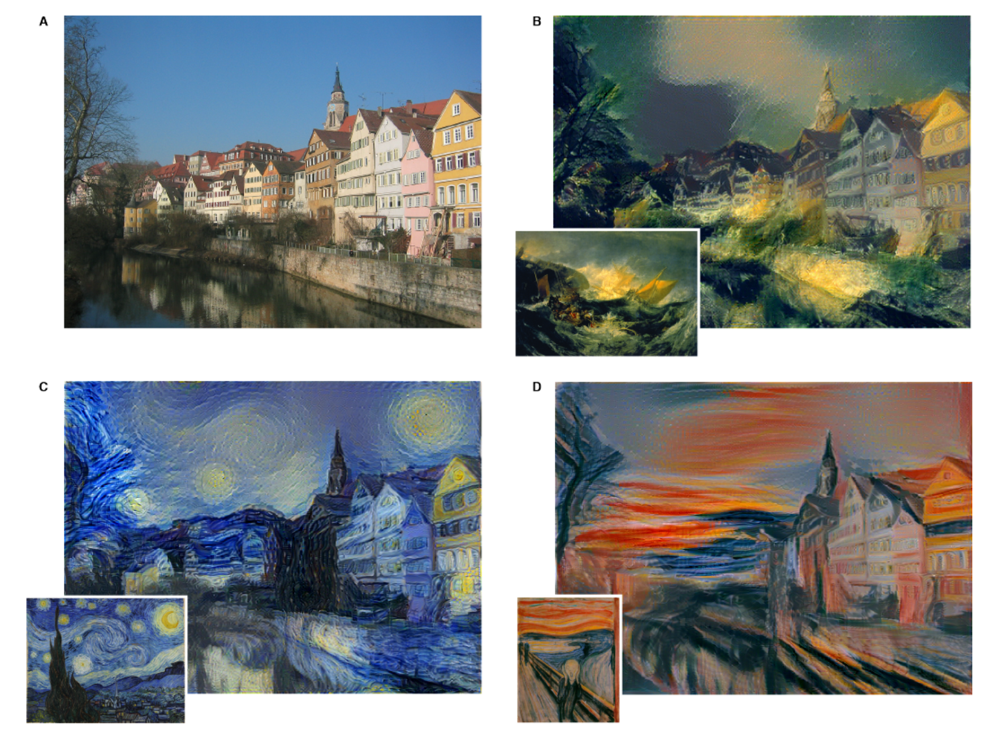
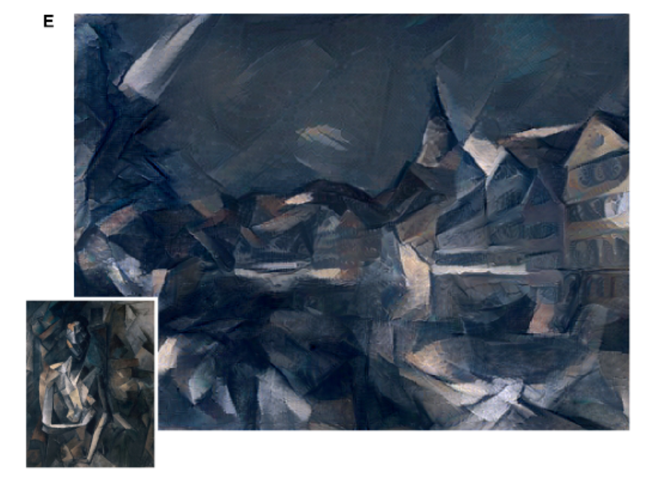
Painting Artist
The Shipwreck of the Minotaur J.M.W. Turner
1803
Femme nue assise Pablo Picasso, 1910
The Starry Night Vincent van Gogh
1889
Gatys, L. A., Ecker, A. S., & Bethge, M. (2015). A neural algorithm of artistic style.

Slide 11
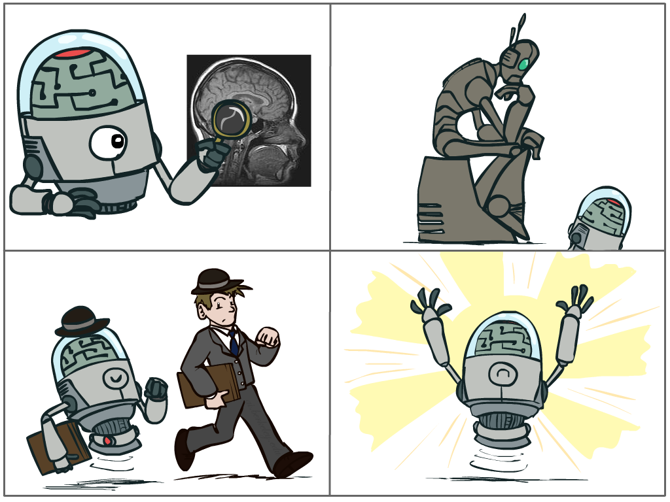
What is AI?
The science of making machines that:
Think like people
Think rationally
Act like people
Act rationally
Notes:
Top left: Think like people --- cognitive science, neuroscience
Bottom left: act like people --- actually very early definition, dating back to Alan Turing --- Turing test; problem to do really well you start focusing on things like don’t answer too quickly what the square root of 1412 is, don’t spell too well, and make sure you have a favorite movie etc. So it wasn’t really leading us to build intelligence
Think rationally – long tradition dating back to Aristotle --- but not a winner, because difficult to encode how to think, and in the end it’s not about how you think, it’s about how you end up acting

Slide 12
Rational Decisions
We’ll use the term rational in a very specific, technical way:
Rational: maximally achieving pre-defined goals
Rationality only concerns what decisions are made
(not the thought process behind them)
Goals are expressed in terms of the utility of outcomes
Being rational means maximizing your expected utility
Notes:
Example of utilities. 10 for A, 1 for each Friday with friends

Slide 13
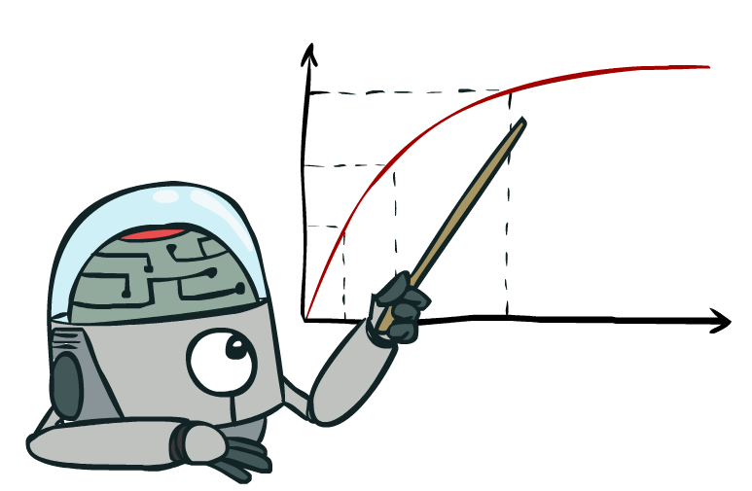
Maximize Your
Expected Utility

Slide 14
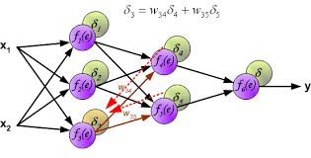
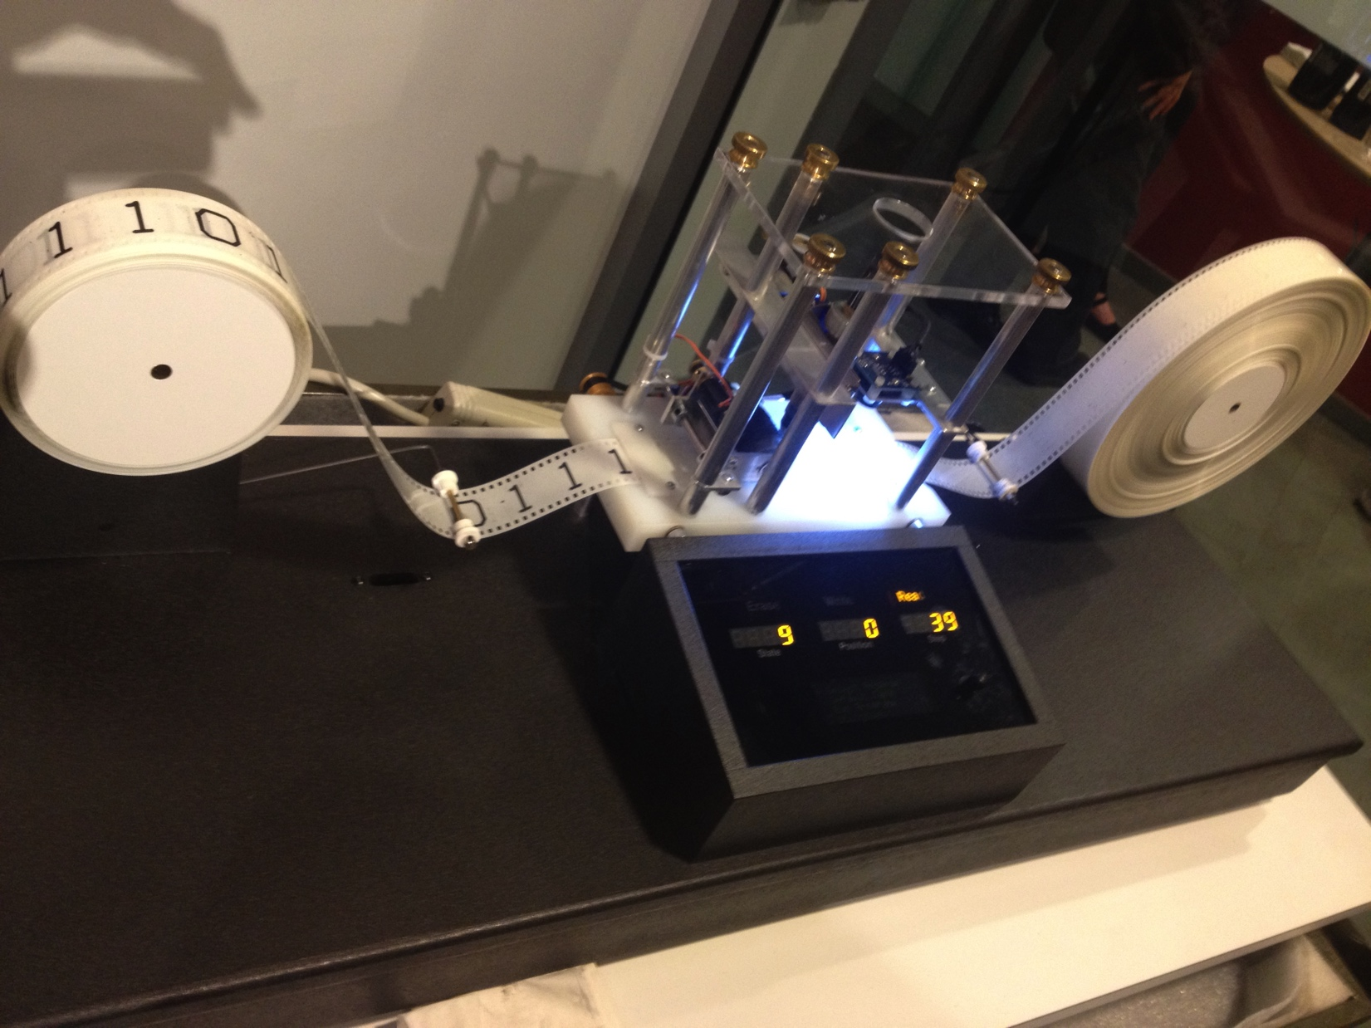
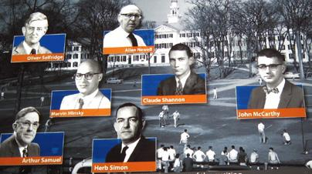
Milestones of AI
BP Algorithm for
Neural Networks
1956 Dartmouth Conference
Marvin Minsky (MIT)
John McCarthy
Claude Shannon (Bell)
Nathan Rochester (IBM)
Turing Machine
Turing Award
1936
1956
1966
1986
6
Notes:
磁带，读写头，状态寄存器，词表

Slide 15
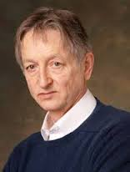
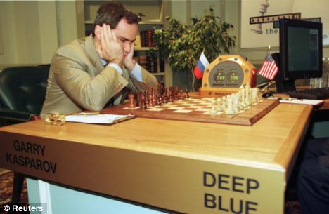
Milestones of AI
Geoffrey Hinton
DNN，Deep Learning
IBM Watson
Human-level QA
Alpha Go: Go Master
Deep
Reinforcement
Learning
IBM Deep Blue
Beats Kasparov in Chess
1997
2006
2011
2016
6

Slide 16
A (Short) History of AI
1940-1950: Early days
1943: McCulloch & Pitts: Boolean circuit model of brain
1950: Turing's “Computing Machinery and Intelligence”
1950—70: Excitement: Look, Ma, no hands!
1950s: Early AI programs, including Samuel's checkers program, Newell & Simon's Logic Theorist, Gelernter's Geometry Engine
1956: Dartmouth meeting: “Artificial Intelligence” adopted
1965: Robinson's complete algorithm for logical reasoning
1970—90: Knowledge-based approaches
1969—79: Early development of knowledge-based systems
1980—88: Expert systems industry booms
1988—93: Expert systems industry busts: “AI Winter”
1990—: Statistical approaches
Resurgence of probability, focus on uncertainty
General increase in technical depth
Agents and learning systems… “AI Spring”?
2006—: neural network, deep learning
Notes:
Million dollar computer with less computation than your phone
MT was

Slide 17
AI Genre
Symbolism
Logic, symbol, expert systems
Allen Newell and Herbert A. Simon
Connectionism
Perceptron (1960), neural network(1970~1990), deep learning
Warren McCulloch, Walter Pitts, Frank Rosenblatt, Marvin Minsky and Seymour Papert
Behaviorism
Control, planning, robotics
Rodney Brooks
Notes:
PDP's direct roots were the perceptron theories of researchers such as Frank Rosenblatt from the 1950s and 1960s. But perceptron models were made very unpopular by the book Perceptrons by Marvin Minsky and Seymour Papert, published in 1969. It demonstrated the limits on the sorts of functions that single-layered (no hidden layer) perceptrons can calculate, showing that even simple functions like the exclusive disjunction (XOR) could not be handled properly. The PDP books overcame this limitation by showing that multi-level, non-linear neural networks were far more robust and could be used for a vast array of functions.^{[2]}
Many earlier researchers advocated connectionist style models, for example in the 1940s and 1950s, Warren McCulloch and Walter Pitts(MP neuron), Donald Olding Hebb, and Karl Lashley. McCulloch and Pitts showed how neural systems could implement first-order logic: Their classic paper "A Logical Calculus of Ideas Immanent in Nervous Activity" (1943) is important in this development here. They were influenced by the important work of Nicolas Rashevsky in the 1930s. Hebb contributed greatly to speculations about neural functioning, and proposed a learning principle, Hebbian learning, that is still used today. Lashley argued for distributed representations as a result of his failure to find anything like a localized engram in years of lesion experiments.
1、符号主义 认为人工智能源于数理逻辑。数理逻辑从19世纪末起得以迅速发展，到20世纪30年代开始用于描述智能行为。计算机出现后，又再计算机上实现了逻辑演绎系统。其有代表性的成果为启发式程序LT逻辑理论家，证明了38条数学定理，表了可以应用计算机研究人的思维多成，模拟人类智能活动。正是这些符号主义者，早在1956年首先采用“人工智能”这个术语。后来又发展了启发式算法->专家系统->知识工程理论与技术，并在20世纪80年代取得很大发展。符号主义曾长期一枝独秀，为人工智能的发展作出重要贡献，尤其是专家系统的成功开发与应用，为人工智能走向工程应用和实现理论联系实际具有特别重要的意义。在人工智能的其他学派出现之后，符号主义仍然是人工智能的主流派别。这个学派的代表任务有纽厄尔(Newell)、西蒙(Simon)和尼尔逊(Nilsson)等。 2、连接主义 认为人工智能源于仿生学，特别是对人脑模型的研究。它的代表性成果是1943年由生理学家麦卡洛克(McCulloch)和数理逻辑学家皮茨(Pitts)创立的脑模型，即MP模型，开创了用电子装置模仿人脑结构和功能的新途径。它从神经元开始进而研究神经网络模型和脑模型，开辟了人工智能的又一发展道路。20世纪60~70年代，连接主义，尤其是对以感知机(perceptron)为代表的脑模型的研究出现过热潮，由于受到当时的理论模型、生物原型和技术条件的限制，脑模型研究在20世纪70年代后期至80年代初期落入低潮。直到Hopfield教授在1982年和1984年发表两篇重要论文，提出用硬件模拟神经网络以后，连接主义才又重新抬头。1986年，鲁梅尔哈特(Rumelhart)等人提出多层网络中的反向传播算法(BP)算法。此后，连接主义势头大振，从模型到算法，从理论分析到工程实现，伟神经网络计算机走向市场打下基础。现在，对人工神经网络(ANN)的研究热情仍然较高，但研究成果没有像预想的那样好。 3、行为主义 认为人工智能源于控制论。控制论思想早在20世纪40~50年代就成为时代思潮的重要部分，影响了早期的人工智能工作者。维纳(Wiener)和麦克洛克(McCulloch)等人提出的控制论和自组织系统以及钱学森等人提出的工程控制论和生物控制论，影响了许多领域。控制论把神经系统的工作原理与信息理论、控制理论、逻辑以及计算机联系起来。早期的研究工作重点是模拟人在控制过程中的智能行为和作用，如对自寻优、自适应、自镇定、自组织和自学习等控制论系统的研究，并进行“控制论动物”的研制。到20世纪60~70年代，上述这些控制论系统的研究取得一定进展，播下智能控制和智能机器人的种子，并在20世纪80年代诞生了智能控制和智能机器人系统。行为主义是20世纪末才以人工智能新学派的面孔出现的，引起许多人的兴趣。这一学派的代表作者首推布鲁克斯(Brooks)的六足行走机器人，它被看作是新一代的“控制论动物”，是一个基于感知-动作模式模拟昆虫行为的控制系统。

Slide 18
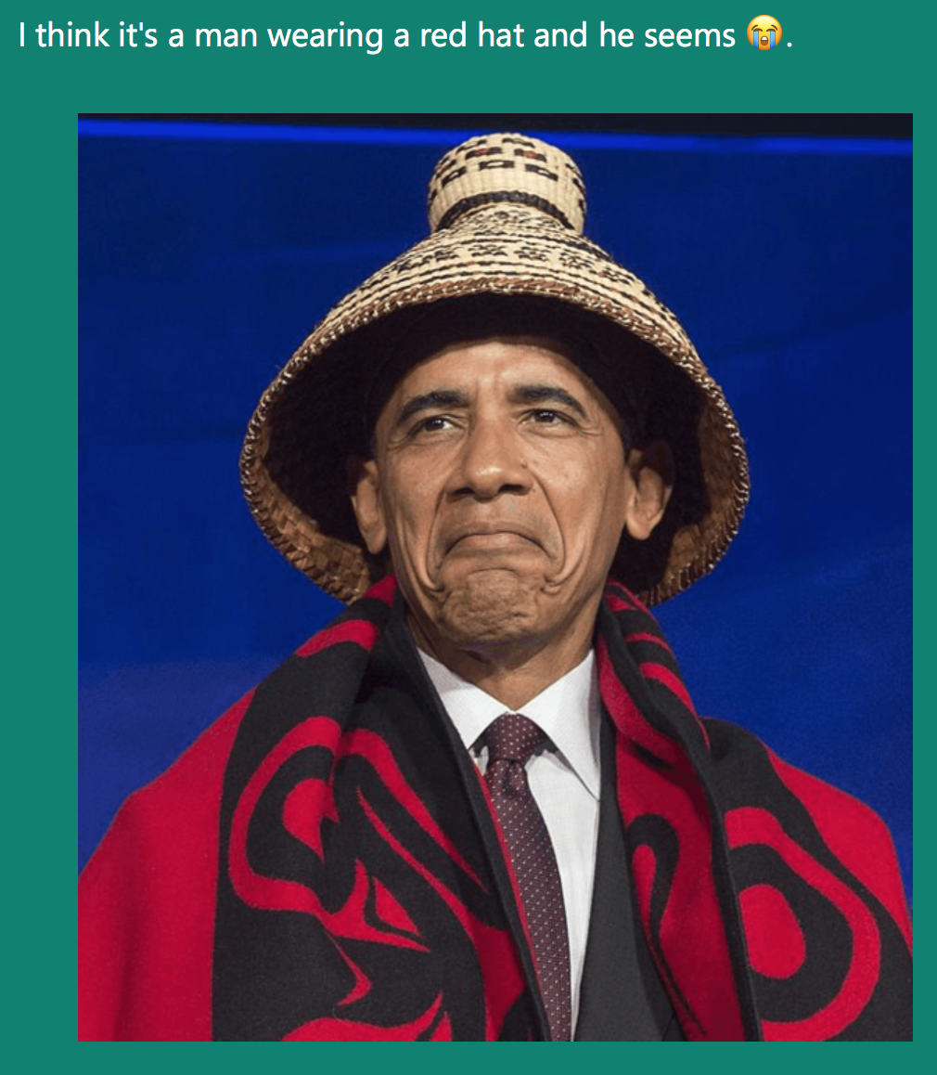
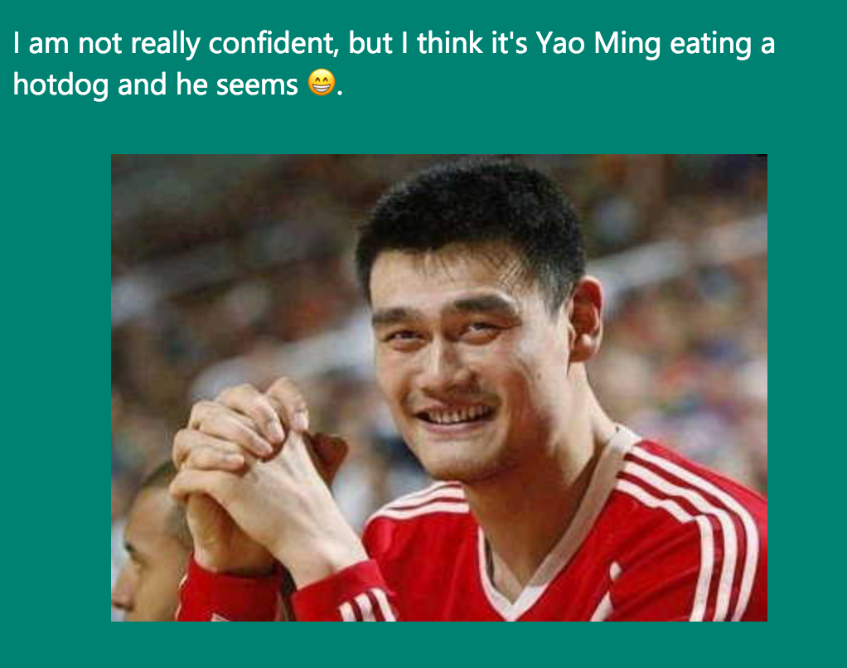
Image to Text
https://www.captionbot.ai/

Slide 19
From Image/Video to Language Generation
What happened？
A man standing next to a crashed motorcycle.
Nasrin Mostafazadeh; Ishan Misra; Jacob Devlin; Margaret Mitchell; Xiaodong He; Lucy Vanderwende. Generating Natural Questions About an Image. ACL 2016

Slide 20
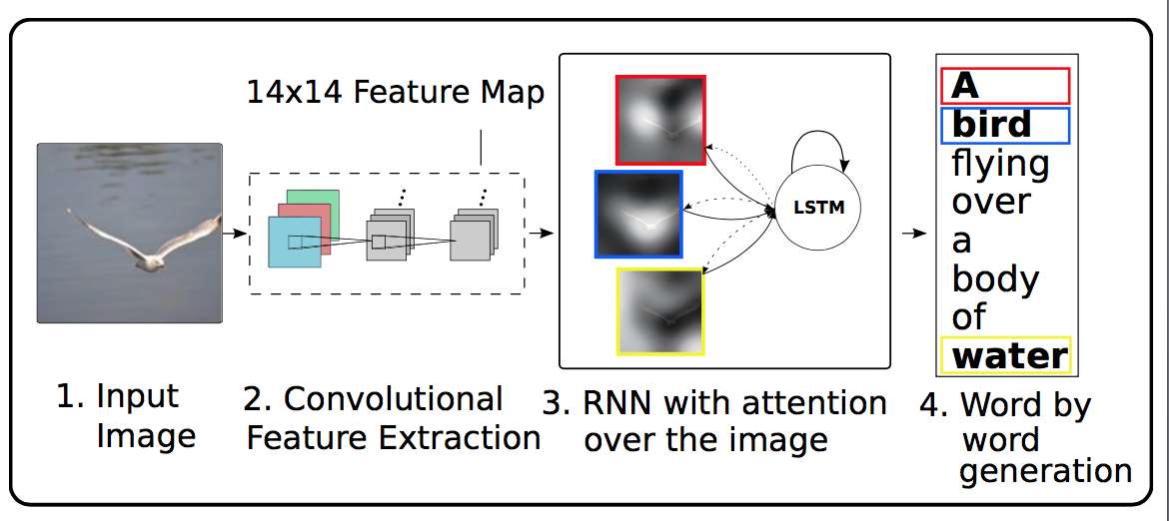
Generating a Caption for an Image

Slide 21
IBM Watson： Understanding Human Languages

Slide 22
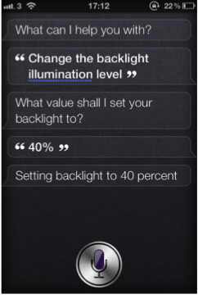
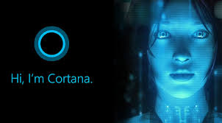
Virtual assistants

Slide 23
Computer learning to play games

