Slide 1
RL MP2
2025/11/28

Slide 2
DP: Value Iteration & Policy Iteration
问题不大

Slide 3
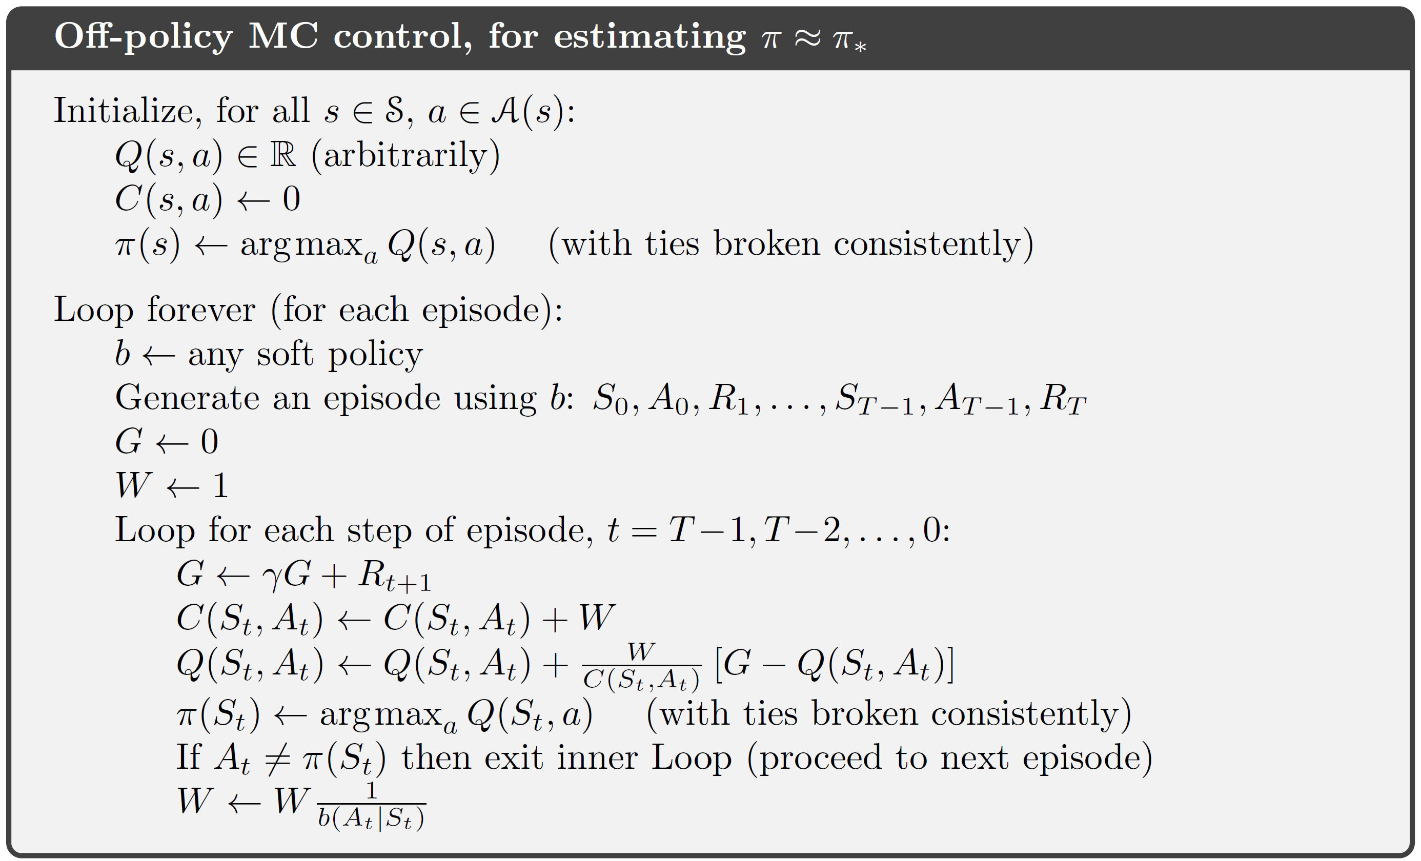
Off-Policy MC
Behavior policy的值容易出现的错误
永远用greedy ×
Q发生更新！
当前的greedy不一定是behavior采样时的greedy

Slide 4
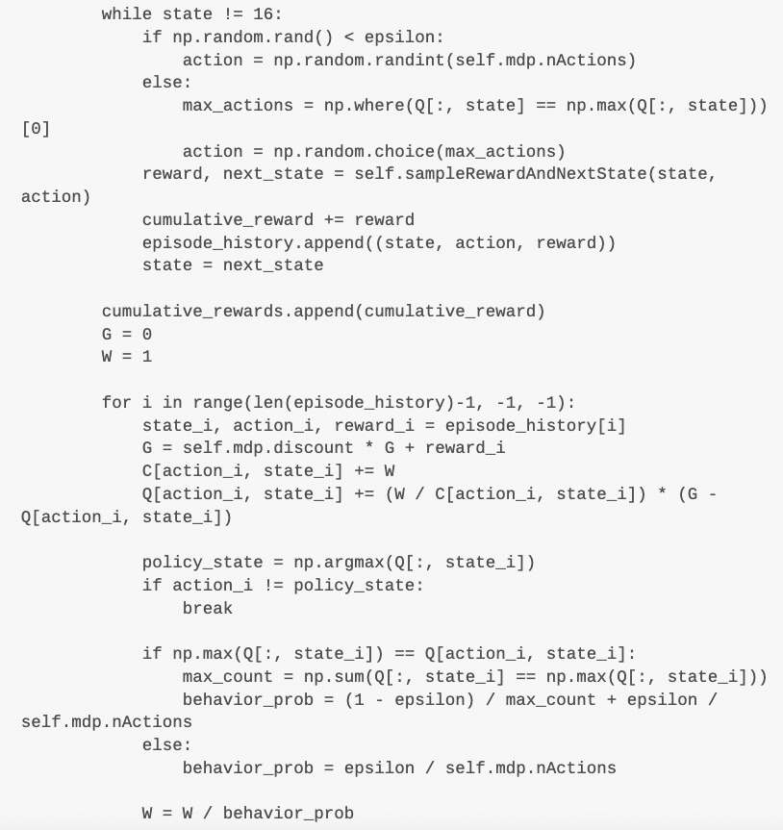
Off-Policy MC
Behavior policy的值容易出现的错误
用当前的Q计算是否为greedy ×
同理，Q发生了变化，greedy也将发生变化

Slide 5
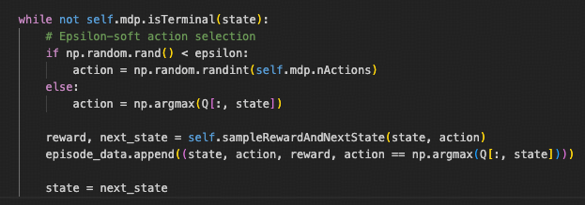
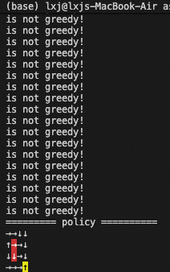
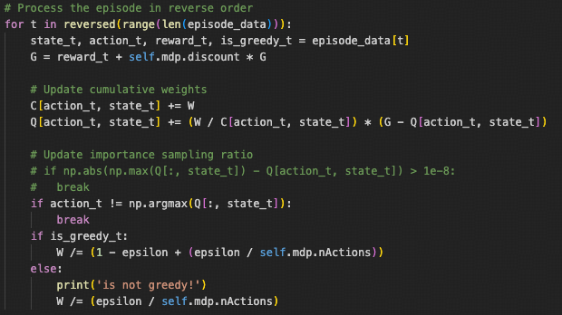
Off-Policy MC

Slide 6
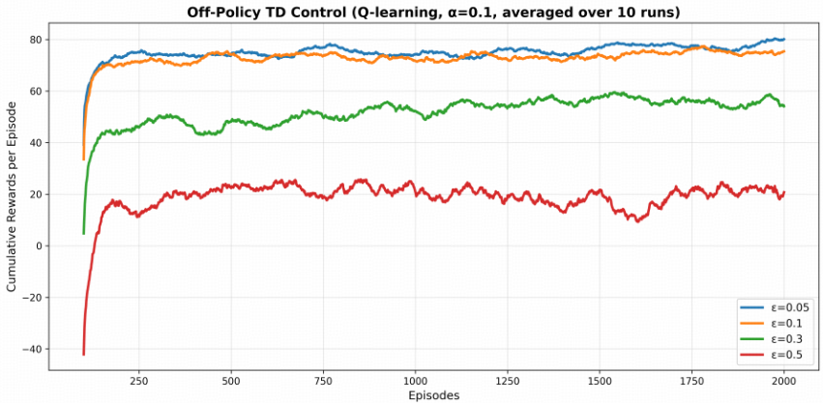
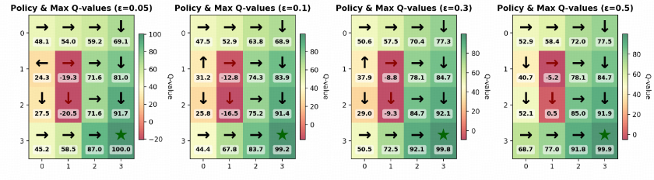
Off-Policy TD
Behavior policy performance
Target policy (Q value) performance
(We care more about)

